Slide 1
AM/FM radio reaches consumers during holiday weeks
% of adults 18+ reached by AM/FM radio, Monday through Sunday midnight-midnight
Source: Nielsen Audio, 48 PPM Markets, Weekly Cume Rating, M-Su 12m-12m, November 2023 – October 2024
Holidays reflect corresponding PPM survey weeks in 2023-2024

Slide 2
AM/FM radio reaches consumers during holiday weekends
% of adults 18+ reached by AM/FM radio, Saturday through Sunday midnight-midnight
Source: Nielsen Audio, 48 PPM Markets, Weekly Cume Rating, Sa-Su 12m-12m, November 2023 – October 2024
Holidays reflect corresponding PPM survey weeks in 2023-2024

Slide 3
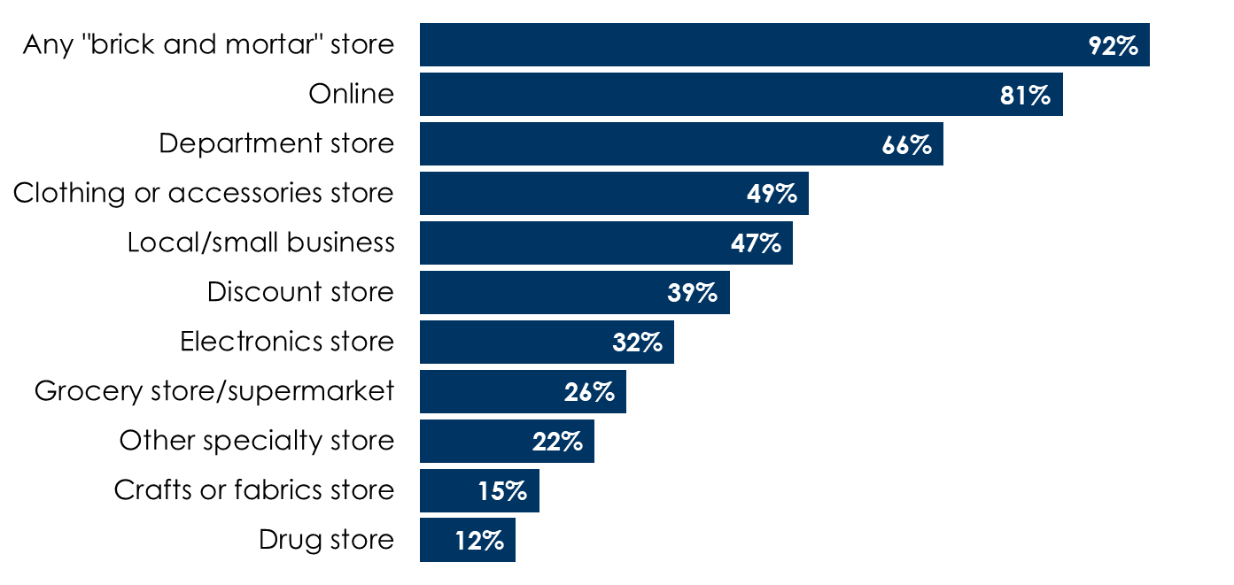
Consumers shop at brick and mortar stores
Where consumers plan to do holiday shopping
Source: MARU/Matchbox National Community Study – October 2018

Slide 4
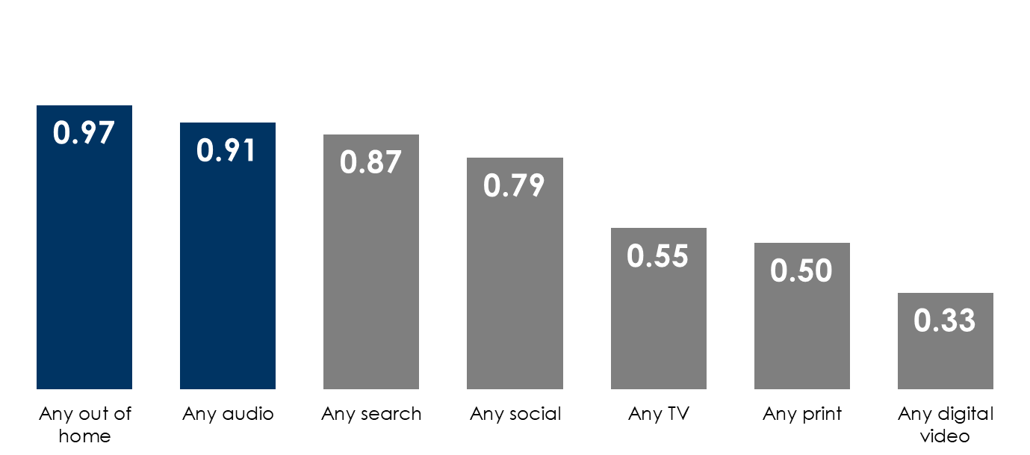
Audio and out-of-home media influence
purchase decisions most
Correlation of purchase activity with media usage
How to read: This chart shows a metric called a correlation. The greater the number, the greater the relationship between media exposure and purchase decisions. 0.91 for audio ads indicates a strong relationship between audio ad exposure and purchase decisions.
Source: Starcom Mediavest Group | Reaching Consumers During the Purchasing Process | June 2016

Slide 5
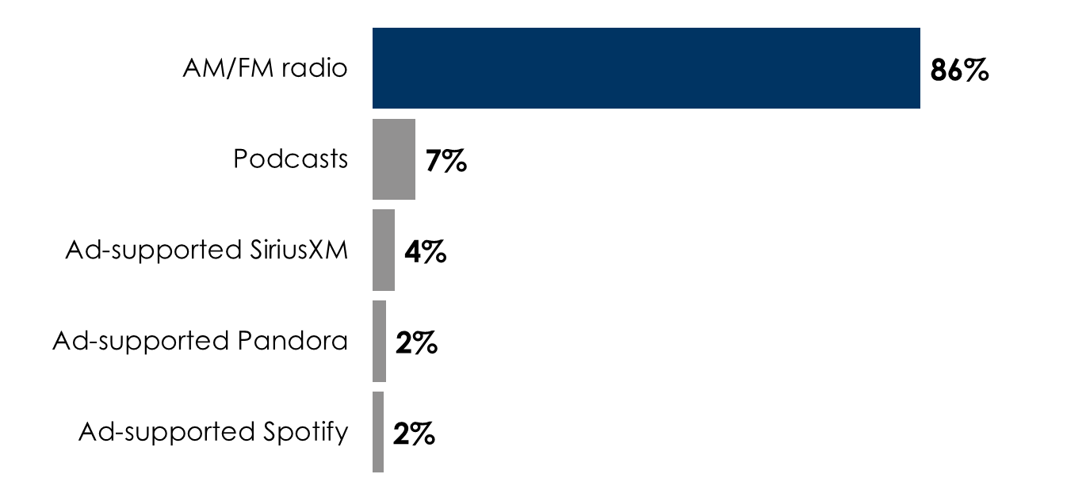
AM/FM radio rules in-car ad-supported audio
Share of ad-supported audio time spent in-car among persons 18+
Source: Edison Research, "Share of Ear,” Q4 2023 – Q3 2024. Persons 18+, in the car; SiriusXM: Ad-supported: Spoken Word. Ad-free: Music; Podcasts listened to on streaming platforms are included in 'podcasts;' Percentages may not add up to 100 due to rounding.

Slide 6
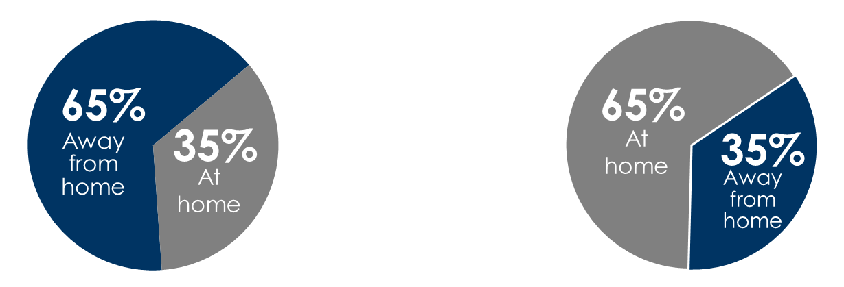
AM/FM radio reaches consumers on the path to purchase
Most streaming listening occurs at home as background music
AM/FM radio location of listening
Ad-supported pure-play streaming location of listening
Source: AM/FM location of listening: Nielsen National Regional Database for Persons 18+ - Q4 2022. Ad-supported pure-play streaming (Pandora (free), Spotify (free), Amazon Music, iHeart, SoundCloud, other streaming services): Edison Research, "Share of Ear,” Q4 2023 – Q3 2024. Persons 18+.

Slide 7



AM/FM radio drives ROI for retail
 | Total shoppers | Total sales | Return in sales per $1 of AM/FM radio
Department stores | +3% | +10% | $17
Mass merchandisers | +2% | +1% | $16
Source: Nielsen ROAS Studies 2015. based on 2014/2013 brand performance comparisons

Slide 8
Grocery | $23
Auto aftermarket | $21
Department store | $17
Mass merchandiser | $16
Home improvement retailer A | $15
Gasoline retailer | $12
Retail | $11
Home improvement retailer B | $9
Average | $16
$16 of retail sales per $1 spent in AM/FM radio
Source: Nielsen 2014-2019

Slide 9
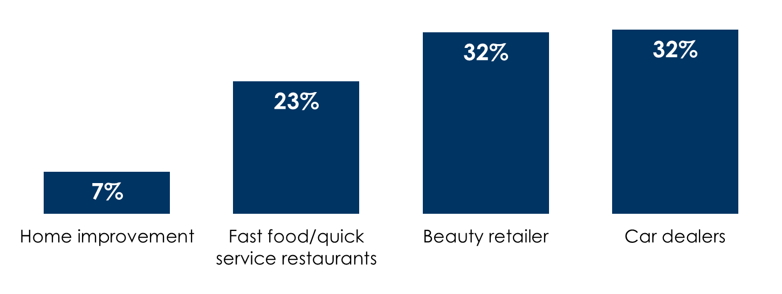
AM/FM radio drives store traffic
% store traffic lift among those exposed
(average of 3 retailers)
(average of 2 retailers)
(average of 2 dealers)
(average of 3 retailers)
Source: Radio Drives Store Traffic, Dial Report and the Radio Advertising Bureau, July 2018

Slide 10

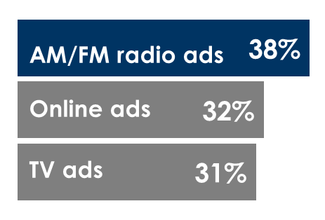

Case studies:
AM/FM radio creates digital impact
330 auto dealers:
Increased website traffic
Amazon Prime Day:
Strongest sales conversion
Home improvement brand:
Significant website visitation
AM/FM radio was most
effective at converting awareness into purchases
Hearing the AM/FM radio campaign 3+ times drove
Auto dealers see
+11%
49%
more new website visitors when
AM/FM radio ads are airing
to visit the retailer’s website
Source: Auto dealers: NumericOwl, Automotive January 2018-September 2018. Amazon Prime Day: Westwood One Radio Network Commissioned Study - IPSOS Amazon Prime Day Survey of 2,010 Americans 18+ July 16, 2018-July 17, 2018 36-hour event. Home improvement brand: Nielsen Study - Westwood One Q3 2016 home improvement brand radio campaign.

